Slide 1

CREDIT AND TRUST

Slide 2
Presented By:
Apeksha Sunil Sawardekar(46256728)
Pallavi Ramchandra Mali(46256729)
Saraswati Vyankatrao Natve(46256606)
Divya Ashok Shedge(46256716)
Prakerla Geetha Sri(46256741)

Slide 3




PROBLEM DEFINITION: 'Credit & Trust', is a newly launched banking division. Due to recent regulatory requirements, there is a need to establish credit worthiness of each Credit application, prior to approval and processing. ‘Credit & Trust’ captures data related to the Credit application of all masked customers. As would be the case, these are all in different places and different formats for different Credit products (Home/Personal/Vehicle). The bank looks forward for a Credit Risk Scorecard that can be leveraged to Approve/Decline the Credit application. To get that insight, 'Credit & Trust' wants to create a Data Warehouse solution on which they can do data analytics.
INTRODUCTION:

Slide 4
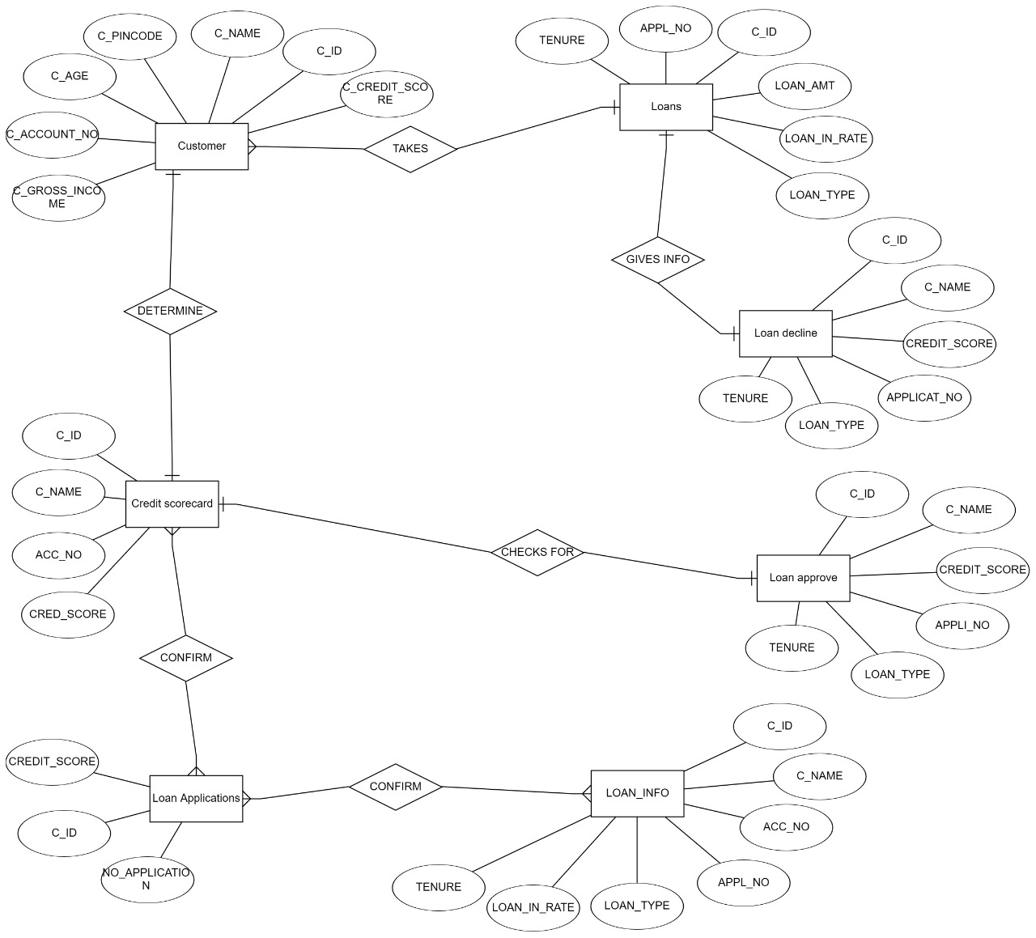
Entity Relationship Diagram:

Slide 5
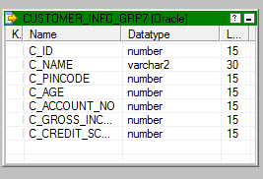
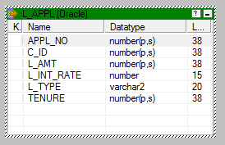
Table Description
Source Tables :
1] CUSTOMER_INFO_GRP7 ::- 2] L_APPL ::-

Slide 6
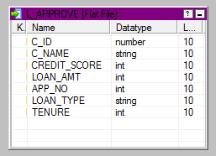
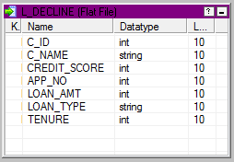
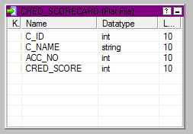
Target Tables : 1 ] For TEST CASE #T1 :
1] L_APPROVE 2] L_DECLINE 3] CRED_SCORECARD

Slide 7
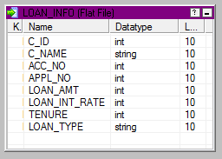
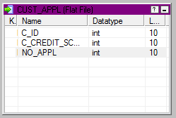
2] For TEST CASE #T2 :
1] LOAN_APPL 2] CUST_APPL

Slide 8
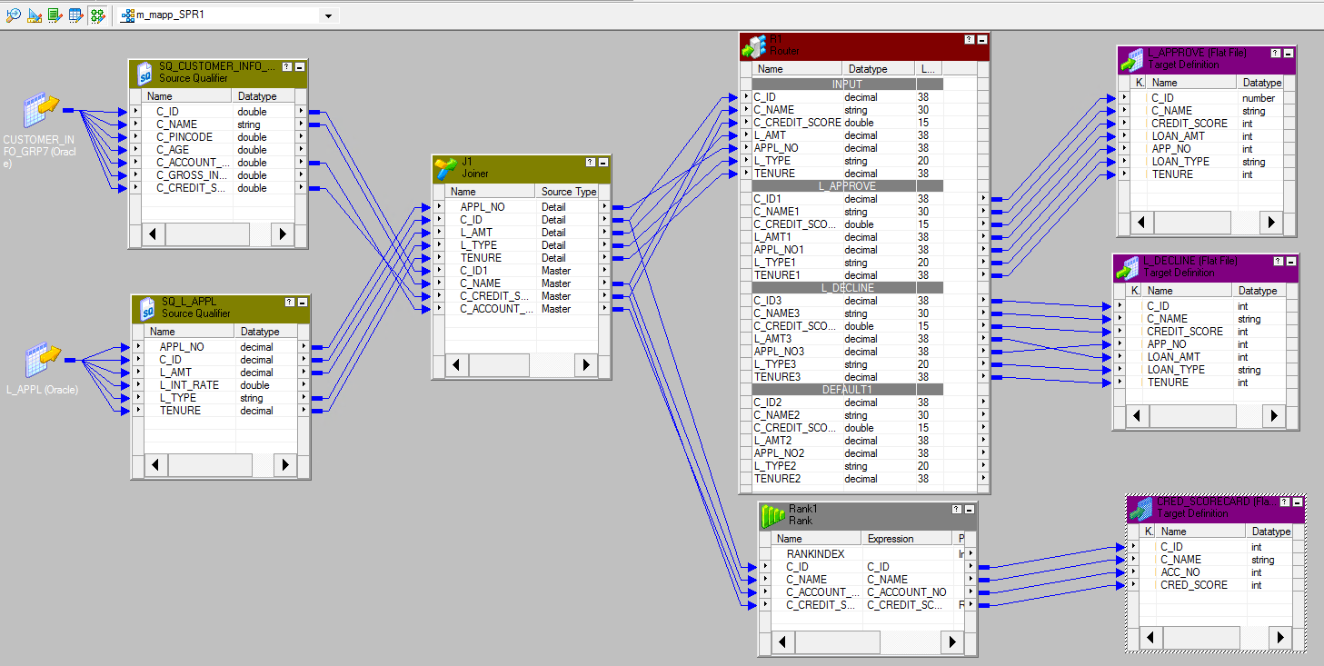
*** Mapping [ TEST CASE #T1 ] ***

Slide 9
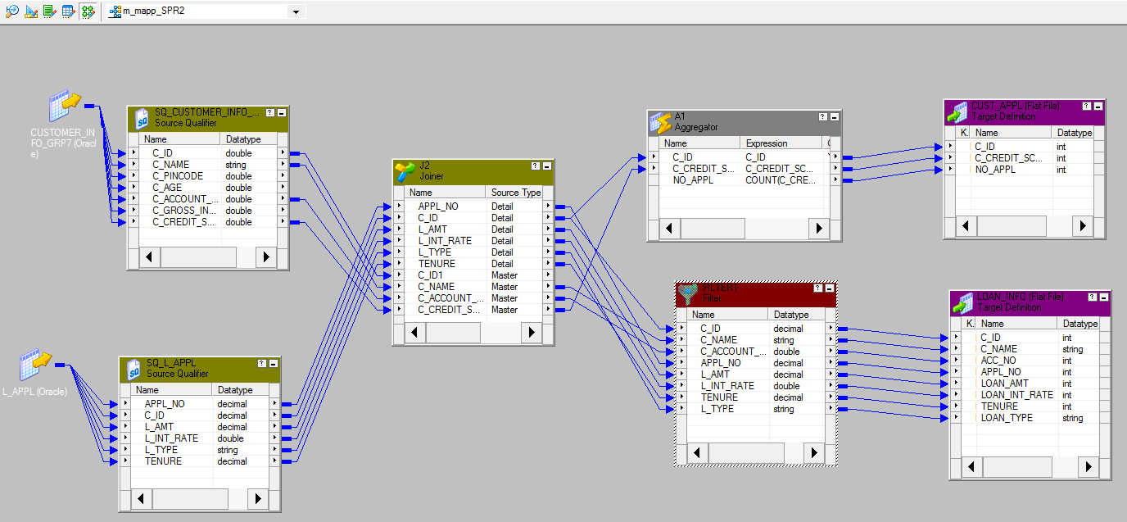
*** Mapping [ TEST CASE #T2 ] ***

Slide 10
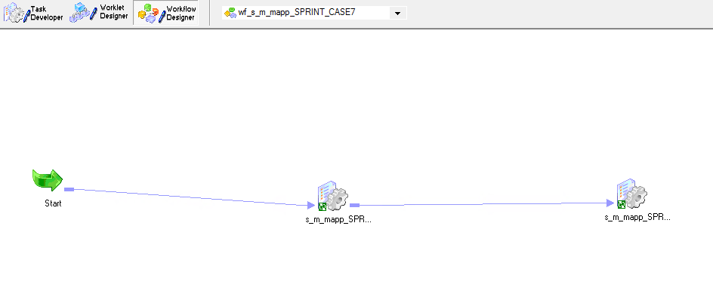
***** Workflow Design For Testcases *****

Slide 11
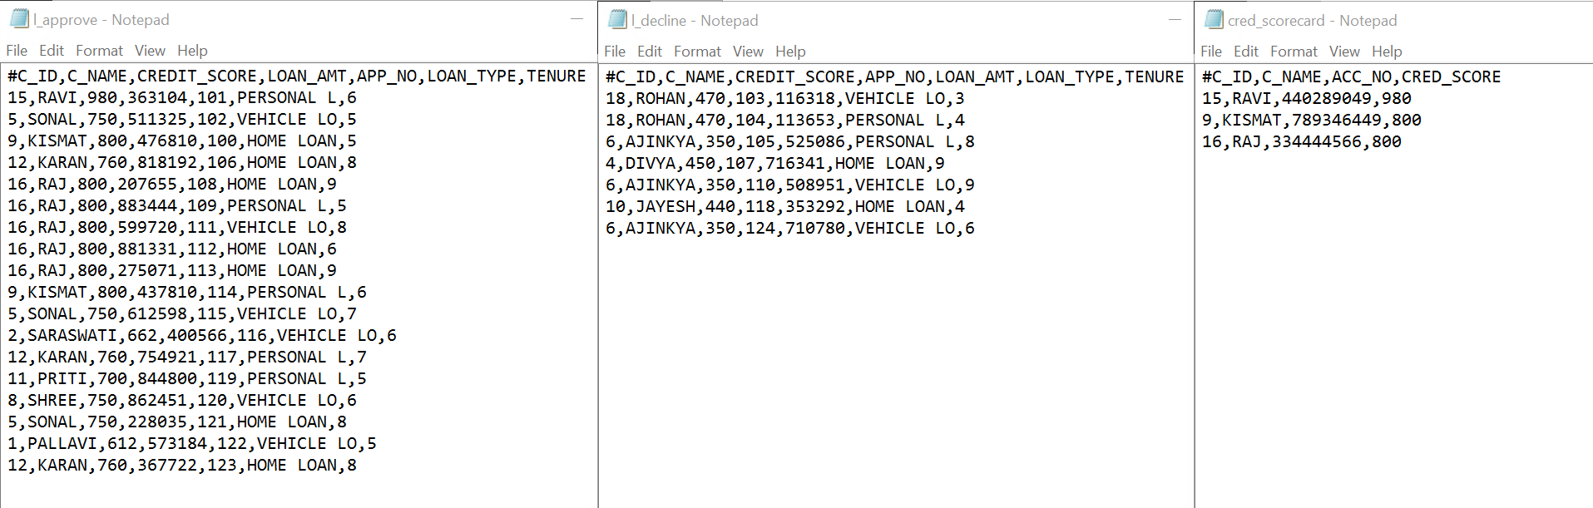
TEST CASE #T1 Output Tables :-

Slide 12
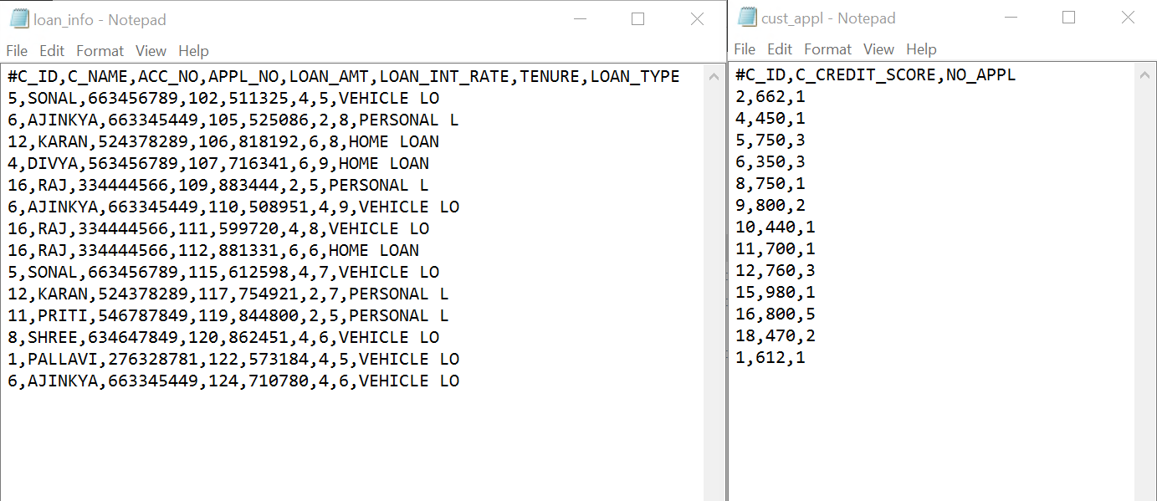
TEST CASE #T2 Output Tables :-

Slide 13
Unit Testing- Test Case #T1
Test Case Purpose: Validate workflow – WF_S_M_MAPP_SPR1
Test Procedure:
Go to workflow manager
•Open workflow
•Workflows menu-> click on validate
Input Value/Test Data: Sources and targets are available and connected
Sources: CUSTOMER_INFO_GRP7, L_APPL
Mappings: M_MAPP_SPR1
Targets: L_APPROVE, L_DECLINE, CRED_SCORECARD
Session: S_M_MAPP_SPR12

Slide 14
Transformations:
•For target table : L_APPROVE
1.JOINER: JOINER transformation used for joining two sources
Here sources joined with condition C_ID1=C_ID
2.ROUTER :ROUTER transformation used for approving loan applications having credit score greater than 500
•For target table : L_DECLINE
1.JOINER: JOINER transformation used for joining two sources
Here sources joined with condition C_ID1=C_ID
2.ROUTER: ROUTER transformation used for declining loan applications having credit score less than equal to 500
•For target table: CRED_SCORECARD
1.RANK: RANK transformation used for ranking top 3 loan applications based on the credit score
Expected Results: Message in workflow manager status bar: “Workflow WF_S_M_MAPP_SPR1 is valid “
Actual Results: Message in workflow manager status bar: “Workflow WF_S_M_MAPP_SPR1 is valid “

Slide 15
Remarks: Pass
Tester Comments:
Retrieved the data from source tables CUSTOMER_INFO_GRP7 and L_APPL grouped it in 2 category approved loan and declined loan applications using transformations. The output is useful to identify the approved loans from which further loan process can be easier and top ranking also help to retrieve data more flexible.

Slide 16
Test Case #T2
Test Case Purpose: Validate workflow – WF_S_M_MAPP_SPR22
Test Procedure:
•Go to workflow manager
•Open workflow
•Workflows menu-> click on validate
Input Value/Test Data: Sources and targets are available and connected
Sources: CUSTOMER_INFO_GRP7, L_APPL
Mappings: M_MAPP_ SPR2
Targets: CUST_APPL , LOAN_INFO
Session: S_M_MAPP_ SPR22
Transformation:
•For target table : CUST_APPL
1.JOINER: JOINER transformation used for joining two sources

Slide 17
2.Aggregator : To COUNT the number of applications .
•For target table : LOAN_INFO
1.JOINER: JOINER transformation used for joining two sources
Here sources joined with condition C_ID1=C_ID.
2.FILTER: FILTER transformation used for retrieving data having loan amount greater than 500000
Expected Results: Message in workflow manager status bar: “Workflow WF_S_M_MAPP_SPR22 is valid “
Actual Results: Message in workflow manager status bar: “Workflow WF_S_M_MAPP_SPR22 is valid “
Remarks: Pass
Tester Comments:
Retrieved the data from source tables CUSTOMER_INFO_GRP7 and L_APPL in order to know the persons ability to take maximum loan amount and number of applications by that applicant.

Slide 18
Integration Testing #T1
It is a type of Software testing in which the different units, modules, or components of a software application are tested as a combined entity.\
Test Case Purpose: Validate workflow – WF_S_M_MAPP_SPR1
Test Procedure:
Go to workflow manager
•Open workflow
•Workflows menu-> click on validate
Input Value/Test Data: Sources and targets are available and connected
Sources: CUSTOMER_INFO_GRP7, L_APPL
Mappings: M_MAPP_SPR1
Targets: L_APPROVE, L_DECLINE, CRED_SCORECARD
Session: S_M_MAPP_SPR12

Slide 19
Transformations:
•For target table : L_APPROVE
1.JOINER: JOINER transformation used for joining two sources
Here sources joined with condition C_ID1=C_ID
2.ROUTER :ROUTER transformation used for approving loan applications having credit score greater than 500
•For target table : L_DECLINE
1.JOINER: JOINER transformation used for joining two sources
Here sources joined with condition C_ID1=C_ID
2.ROUTER: ROUTER transformation used for declining loan applications having credit score less than equal to 500
•For target table: CRED_SCORECARD
1.RANK: RANK transformation used for ranking top 3 loan applications based on the credit score

Slide 20
Expected Results: Message in workflow manager status bar: “Workflow WF_S_M_MAPP_SPR1 is valid “
Actual Results: Message in workflow manager status bar: “Workflow WF_S_M_MAPP_SPR1 is valid “
Remarks: Pass
Tester Comments:
Retrieved the data from source tables CUSTOMER_INFO_GRP7 and L_APPL grouped it in 2 category approved loan and declined loan applications using transformations. The output is useful to identify the more flexible.

Slide 21
Integration Testing #T2
Test Case Purpose: Validate workflow – WF_S_M_MAPP_SPR22
Test Procedure:
•Go to workflow manager
•Open workflow
•Workflows menu-> click on validate
Input Value/Test Data: Sources and targets are available and connected
Sources: CUSTOMER_INFO_GRP7, L_APPL
Mappings: M_MAPP_ SPR2
Targets: CUST_APPL , LOAN_INFO
Session: S_M_MAPP_ SPR22

Slide 22
Transformation:
•For target table : CUST_APPL
1.JOINER: JOINER transformation used for joining two sources
2.Aggregator : To COUNT the number of applications .
•For target table : LOAN_INFO
1.JOINER: JOINER transformation used for joining two sources
Here sources joined with condition C_ID1=C_ID.
2.FILTER: FILTER transformation used for retrieving data having loan amount greater than 500000

Slide 23
Expected Results: Message in workflow manager status bar: “Workflow WF_S_M_MAPP_SPR22 is valid “
Actual Results: Message in workflow manager status bar: “Workflow WF_S_M_MAPP_SPR22 is valid “
Tester Comments:
Retrieved the data from source tables CUSTOMER_INFO_GRP7 and L_APPL in order to know the persons ability to take maximum loan amount and number of applications by that applicant.

Slide 24
REGRESSION TESTING-
Every time a new module is added, it leads to changes in the program. This type of testing makes sure that the whole component works properly even after adding components to the complete program.
We will check here functionality of the mappings.
There are 2 mappings.
1. m_mapp_spr1
2. m_mapp_spr2
1) Test Case ID: M1
Test Case Purpose: Validate Mapping m_mapp_spr1, Validate Workflow wf_m_mapp_spr1
Test Procedure:
• Go to Mapping
• Connect Source and Target
• Use Transformation
• Connect All and then Save it
• Go to menu> mapping> Click on validate
Input Value/Test Data:
Sources: CUSTOMER_INFO_GRP7, L_APPL
Targets: L_APPROVE, L_DECLINE, CRED_SCORECARD

Slide 25
Transformations:
• For target table: L_APPROVE
1) JOINER: JOINER transformation used for joining two sources
Here sources joined with condition C_ID1=C_ID
2) ROUTER: ROUTER transformation used for approving loan applications having credit score greater than 500
• For target table: L_DECLINE
1) JOINER: JOINER transformation used for joining two sources
Here sources joined with condition C_ID1=C_ID
2) ROUTER: ROUTER transformation used for declining loan applications having credit score less than equal to 500
• For target table: CRED_SCORECARD
1) RANK: RANK transformation used for ranking top 10 loan applications based on the credit score
Expected Result:
Check Mapping> Mapping is valid
Go to workflow > Message in workflow manager status bar: “Workflow wf_m_spr1 is valid”
Actual Result:
Message in workflow manager status bar: ”Workflow wf_m_spr1 is valid”

Slide 26
Remarks : Pass
Tester comments:
It is verified that the modifications have not caused unintended effects and that the component still works as specified in the requirements. The transformation of processed data to the target does not impact on the sources and functions it functions as it was before executing the code. The data in the source tables CUSTOMER_INFO_GRP7 and L_APPL is unchanged.
2) Test Case ID: M2
Test Case Purpose: Validate Mapping m_mapp_spr2, Validate Workflow wf_m_mapp_spr22
Test Procedure:
• Go to Mapping
• Connect Source and Target
• Use Transformation
• Connect All and then Save it
• Go to menu> mapping> Click on validate
Input Value/Test Data:
Input Value/Test Data: Sources and targets are available and connected
Sources: CUSTOMER_INFO_GRP7, L_APPL
Targets: CUST_APPL, LOAN_INFO

Slide 27
Transformation:
• For target table: CUST_APPL
1) JOINER: JOINER transformation used for joining two sources
Here sources joined with condition C_ID1=C_ID
2) Aggregator: To COUNT the number of applications.
• For target table: LOAN_INFO
1) JOINER: JOINER transformation used for joining two sources
Here sources joined with condition C_ID1=C_ID.
2) FILTER: FILTER transformation used for retrieving data having loan amount greater than 500000
Expected Result:
Check Mapping> Mapping is valid
Go to workflow > Message in workflow manager status bar: “Workflow wf_m_mapp_spr22 is valid”
Actual Result:
Message in workflow manager status bar: ”Workflow wf_m_mapp_spr22 is valid”
Remarks : Pass
Tester comments:
It is verified that the modifications have not caused unintended effects and that the component still works as specified in the requirements. The transformation of processed data to the target does not impact on the sources and functions as it was before executing the code. The data in the source tables CUSTOMER_INFO_GRP7 and L_APPL is unchanged.

Slide 28

Thank You

